Slide 1

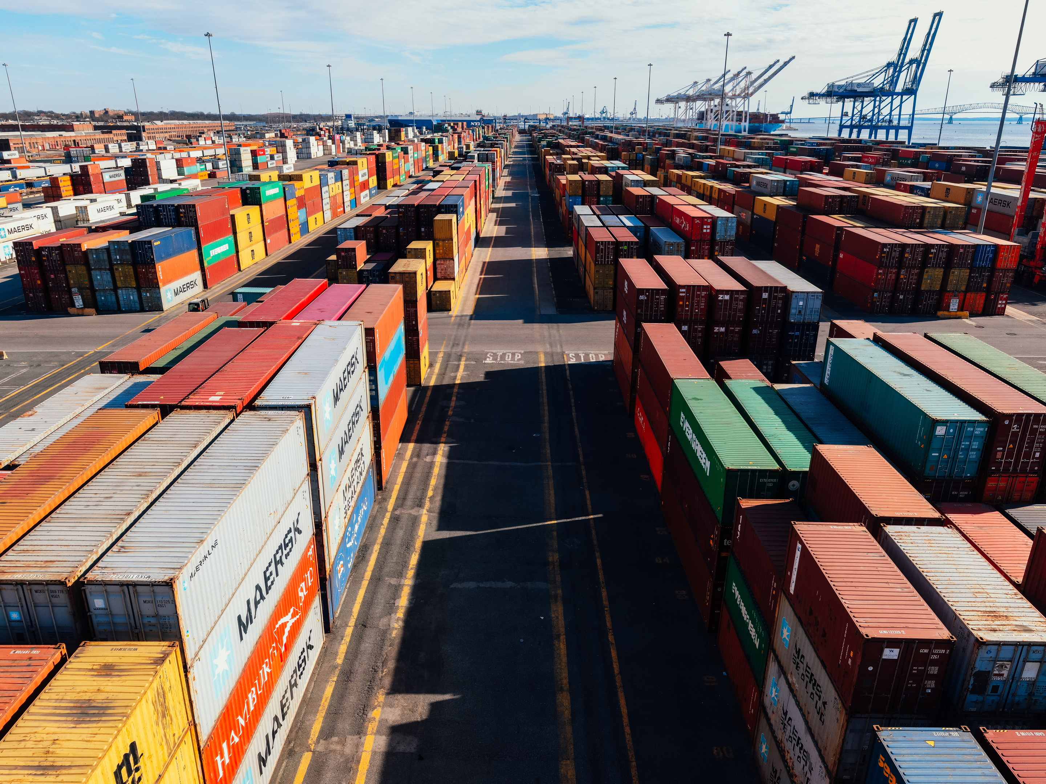
supply chain
REPRESENTED BY :
YOUSSEF TAREK SALEH AHMED
MOSTAFA MOHAMED MOHAMED HABIB
OSMAN ABDALLAH MOHAMED BREAK
HANA OMAR MOHAMED AHMED
SALMA AMR ABDELFATTAH MOHAMMED
FARAH SAMEH AHMED HOSENY
-

Slide 2

overview
Our project is about analyzing and improving the supply chain using Power BI.
We started with raw data that needed cleaning and organizing. After that, we built interactive dashboards to show important information like inventory, orders, and delivery performance

Slide 3


WHY SUPPLY CHAIN?
Critical Role in Business Success: Efficient supply chain management is essential for reducing costs, improving customer satisfaction, and enhancing operational performance.
Importance of Real-Time Insights: In today’s fast-paced, data-driven environment, businesses need instant insights to respond quickly to changes and challenges in their supply chains.
Data-Driven Decision-Making: By analyzing supply chain data with Power BI, businesses can:
Gain a clearer understanding of their operations.
Identify and eliminate bottlenecks.
Make smarter, data-driven decisions for continuous improvement.

Slide 4

Data Cleaning

Slide 5

Derived Columns in Cost Table
Shipping cost per time = Shipping costs / Shipping time
2.Manufacturing cost per unit = Manufacturing costs / Production volumes
3. Transportation cost per order = Transportation costs / Order quantities
4. Profit = Price - (Shipping cost per time + Manufacturing cost per unit + Transportation cost per order)
Revenue Column Correction
The original Revenue column was removed due to inconsistencies.
A new column was calculated as:
Revenue = Product sold × Price

Slide 6

Pricing Scenarios Analysis
Scenario 1: Price is accurate
Using the given price, we calculated profits using the derived columns above.
Result:
- 79 products with profit
- 21 products with loss
Scenario 2: Price is incorrect
We recalculated price as: Revenue / Product sold
Comparing this recalculated price with the cost structure:
- 50 products with profit
- 50 products with loss
- Identified large profit/loss gaps due to incorrect pricing.
Notes:
6

Slide 7

Data Tables Overview

Slide 8
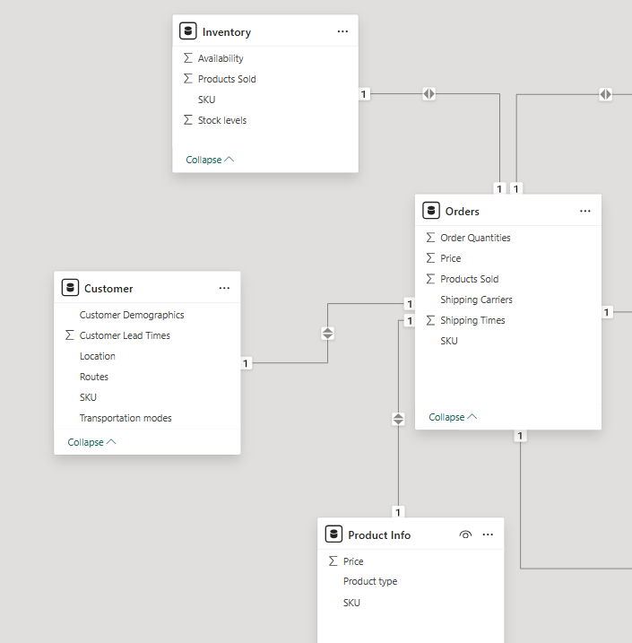
Product Info
- Columns: Product type, SKU, Price
Purpose: Contains basic product identification
and pricing information.
Inventory
-Columns: SKU, Availability, Product sold,
Stock levels
- Purpose: Tracks inventory levels and sales
quantities for each product.
Customer
- Columns: SKU, Customer demographics, Customer lead time, Location, Transportation mode, Routes
- Purpose: Stores information related to the customer profile and logistics.
Orders
- Columns: SKU, Price, Order quantities, Product sold, Shipping carriers, Shipping times
- Purpose: Captures order transaction details including volume, price, and delivery information.

Slide 9
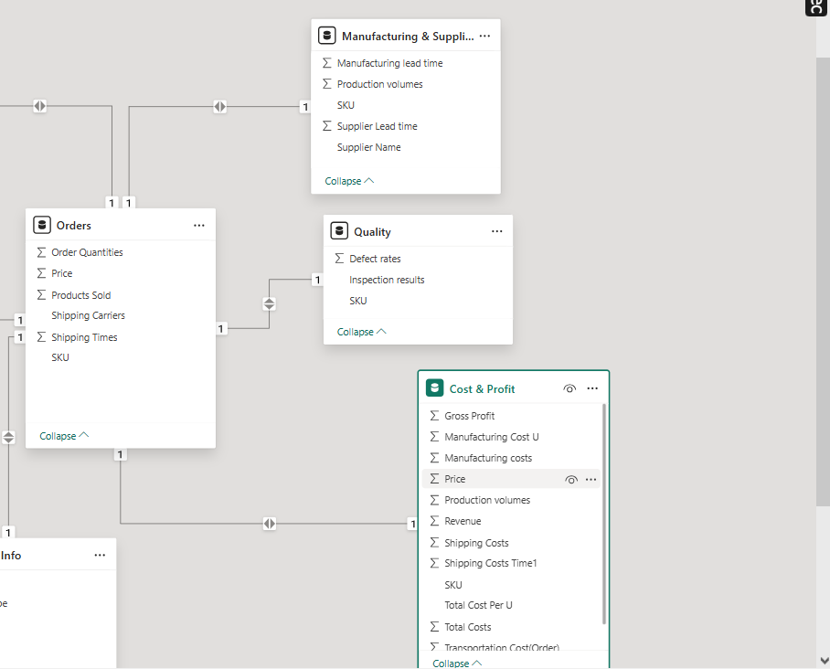
Quality
- Columns: Defect rates, Inspection results, SKU
- Purpose: Records quality control results for each product.
Manufacturing & Suppliers
- Columns: Manufacturing lead time, Production volumes, SKU, Supplier lead time, Supplier name
- Purpose: Includes production metrics and supplier information.
Cost & Profit
- Columns: Manufacturing costs, Manufacturing cost per unit, Price, Production volumes, Profit, Revenue, Shipping costs, Shipping cost per time, SKU, Transportation costs, Transportation cost per order
Fact Table & Data Modeling
The Orders table was selected as the central fact table.
It connects with all other dimension tables using the SKU column as the primary key.

Slide 10
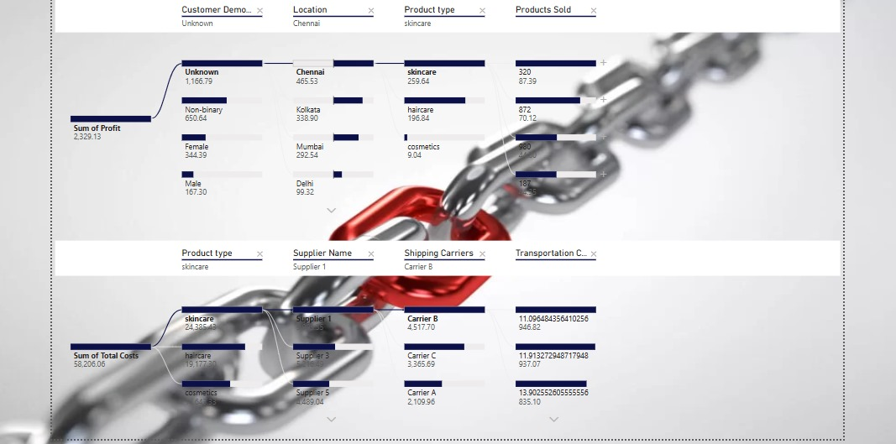

Slide 11
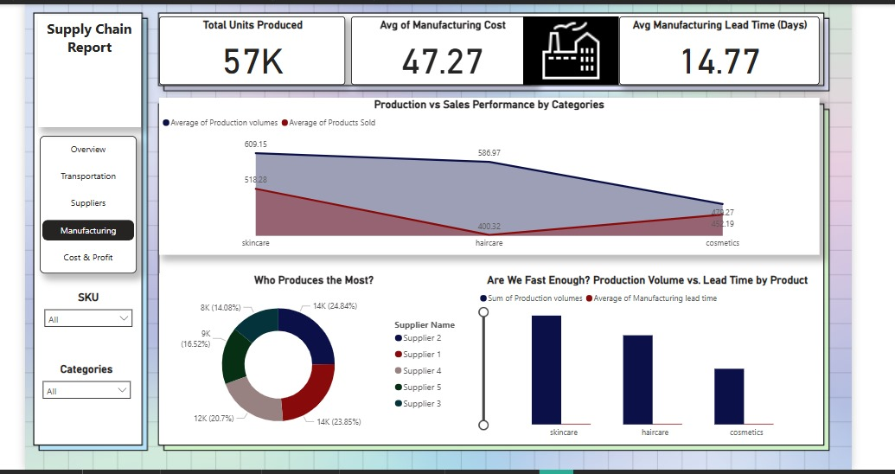

Slide 12
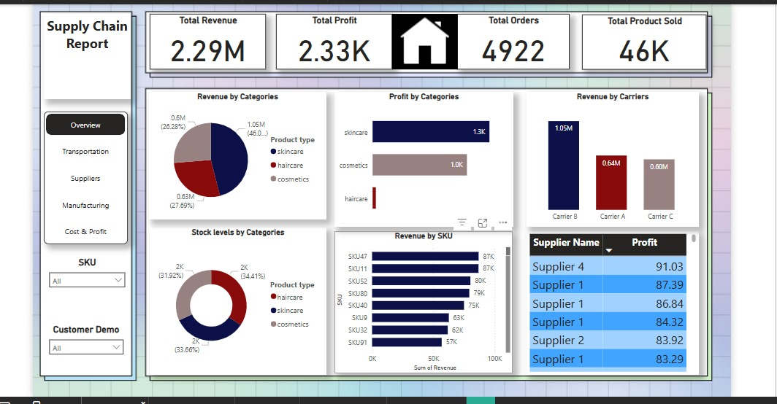

Slide 13
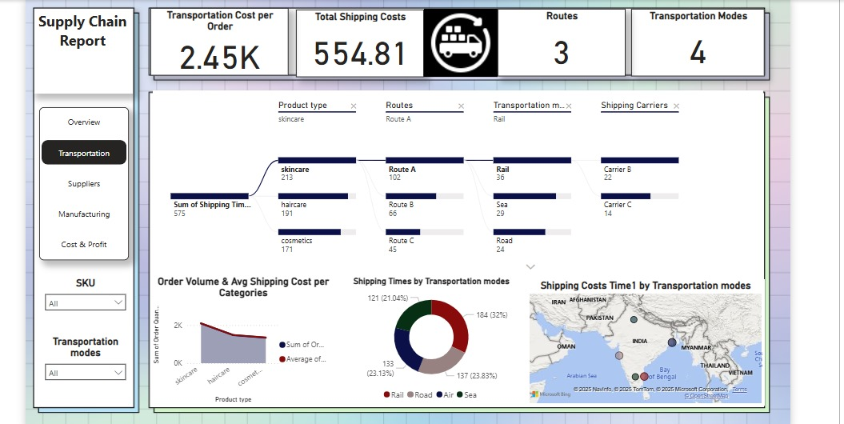

Slide 14
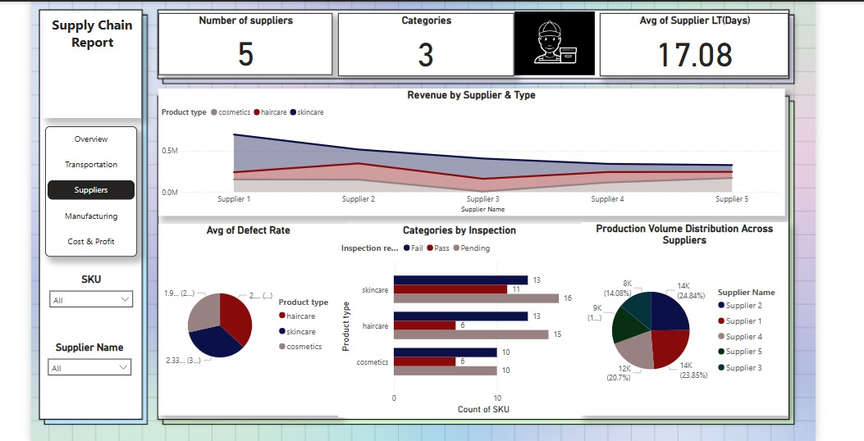

Slide 15
Insights and recommendations

Slide 16

Delivery Lead Time Gap
Revenue varies by Product Type
Dependency on Few SKUs
Quality Variations
Transport Mode Inefficiencies
Geographic Logistics Imbalance

Slide 17
1.End-to-End Tracking System
2. ABC Inventory Segmentation
3. Reassess Supplier Base and Add Backups
4. Reconfigure Warehouse Distribution with Regional Micro-Centers
5. Product Profitability Matrix
6. Smart Transport Selection Algorithm
7. Strengthen Internal Quality Control

Slide 18

conclusion
Revenue Insights: Skincare products earned the most, followed by haircare and cosmetics.
Demand and Production: Skincare had the highest demand, while cosmetics had the lowest.
Logistics Performance: We identified cost and speed trade-offs in transportation.
Supplier Analysis: Supplier performance varied by product, highlighting the need for careful selection.
Process Improvement: Longer customer lead times than manufacturing times showed a need for efficiency improvements.
Overall, this project showed how data can help businesses optimize their supply chains, cut costs, and improve customer satisfaction.

Slide 19
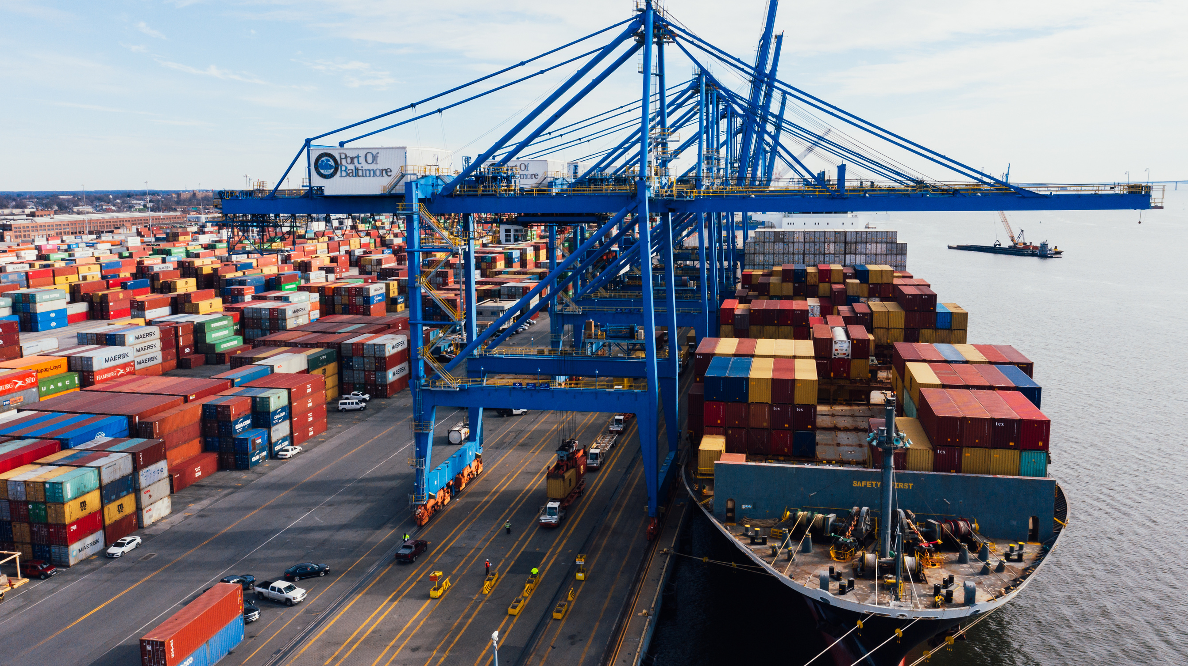
Thank You

